Slide 1
DIGITAL PAYMENT AND FRAUD DETECTION ANALYSIS
Presented by,
Farzana P A

Slide 2
INTRODUCTION
With the rise of online transactions, digital payment fraud has become a major concern.
Detecting fraud manually is inefficient due to the huge volume of transactions.
Machine Learning models can automatically analyze transaction patterns and identify fraudulent activities.
This project focuses on building a system that predicts potential fraud using historical transaction data.

Slide 3
OBJECTIVES
Detect fraudulent digital payments using machine learning.
Analyze transaction data to find risky patterns.
Build models to predict fraud accurately.
Help prevent financial losses and improve security.

Slide 4
PROCESS OF DATASET
Data Collection – Gathered from Kaggle with 7500 transactions and 15 columns.
Data Cleaning – Removed duplicates, handled missing values.
Data Preprocessing – Encoded categorical features, scaled numerical features.
Feature Selection – Choose important features affecting fraud detection.
Model Selection – Used Logistic Regression, Random Forest, KNN,SVM,Gradient Boosting
Model Training & Testing – Split data into training and testing sets, trained models.
Evaluation – Checked accuracy, confusion matrix and classification report.

Slide 5
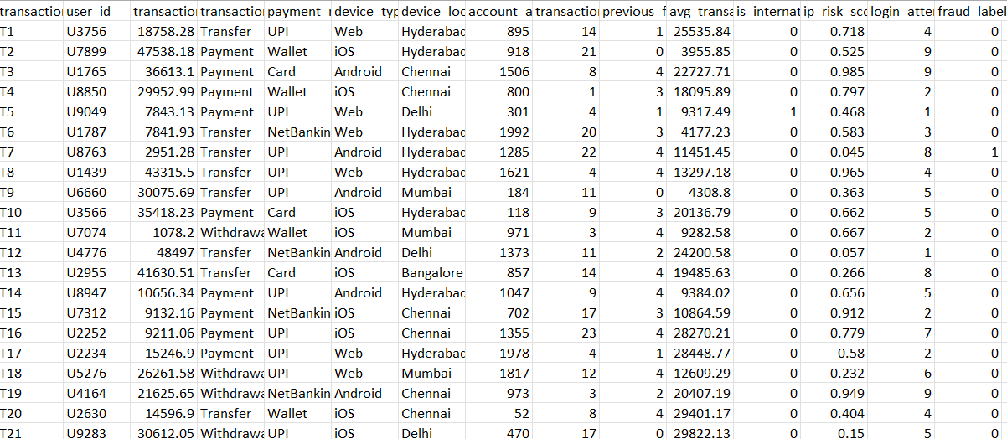
DATASET

Slide 6
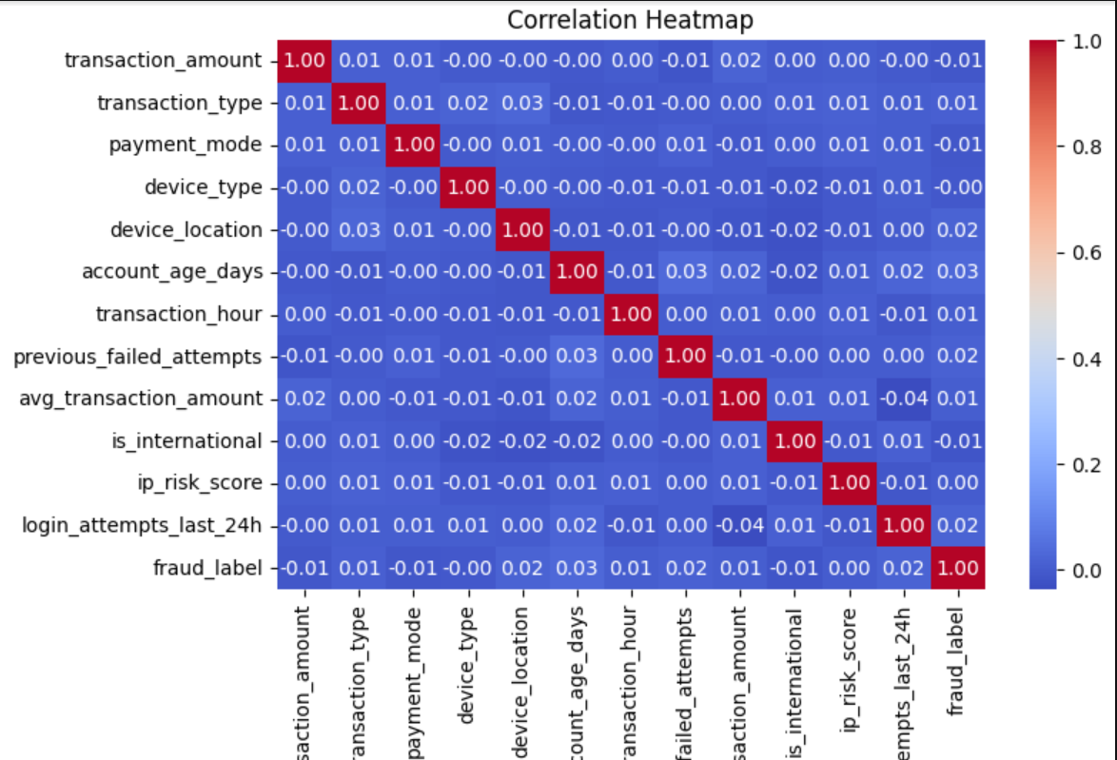
CORRELATION HEATMAP

Slide 7
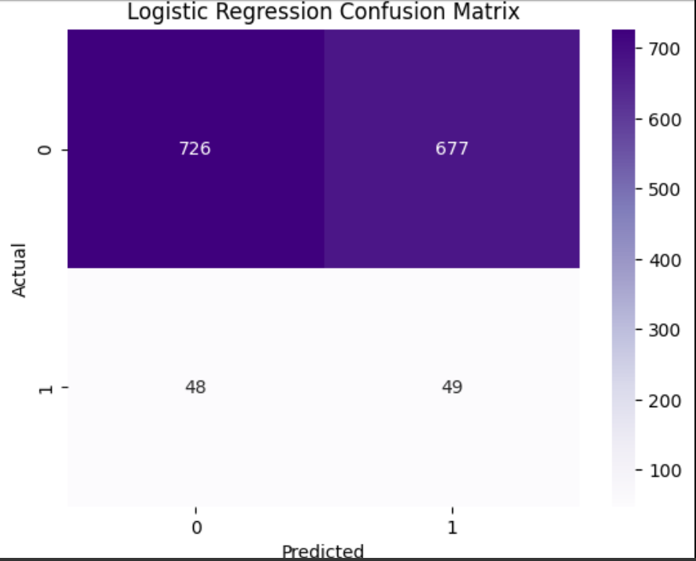
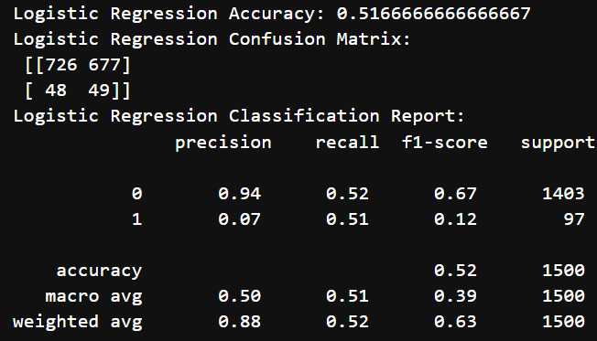
RESULT OBTAINED
Logistic Regression

Slide 8
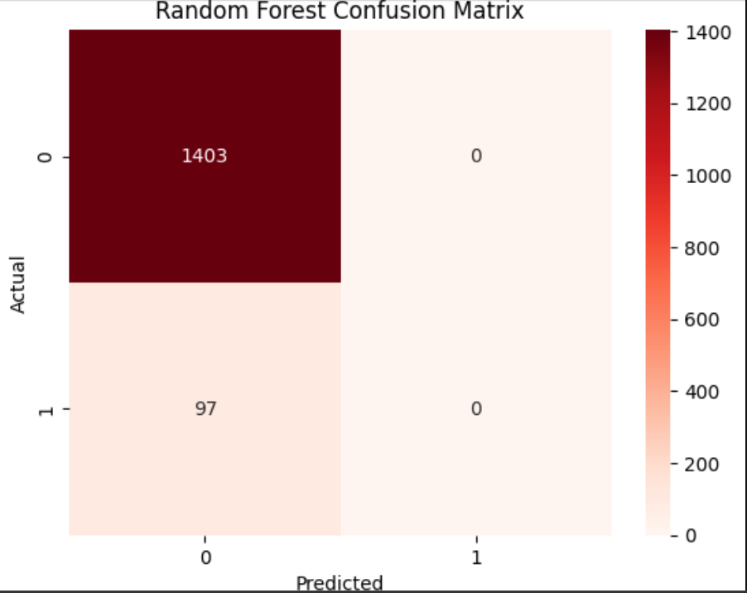
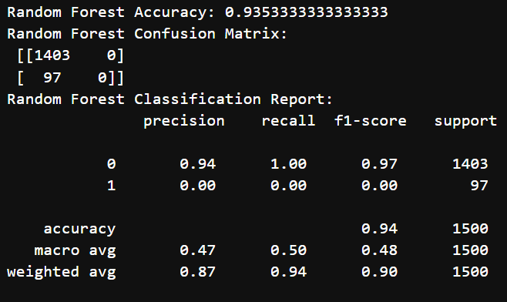
RESULT OBTAINED
Random Forest

Slide 9
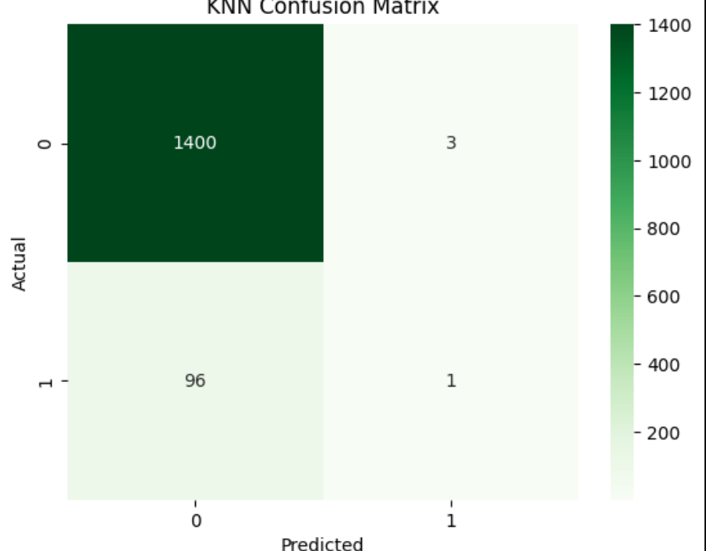
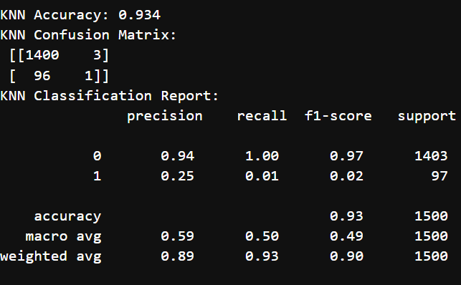
RESULT OBTAINED
K-Nearest Neighbors

Slide 10
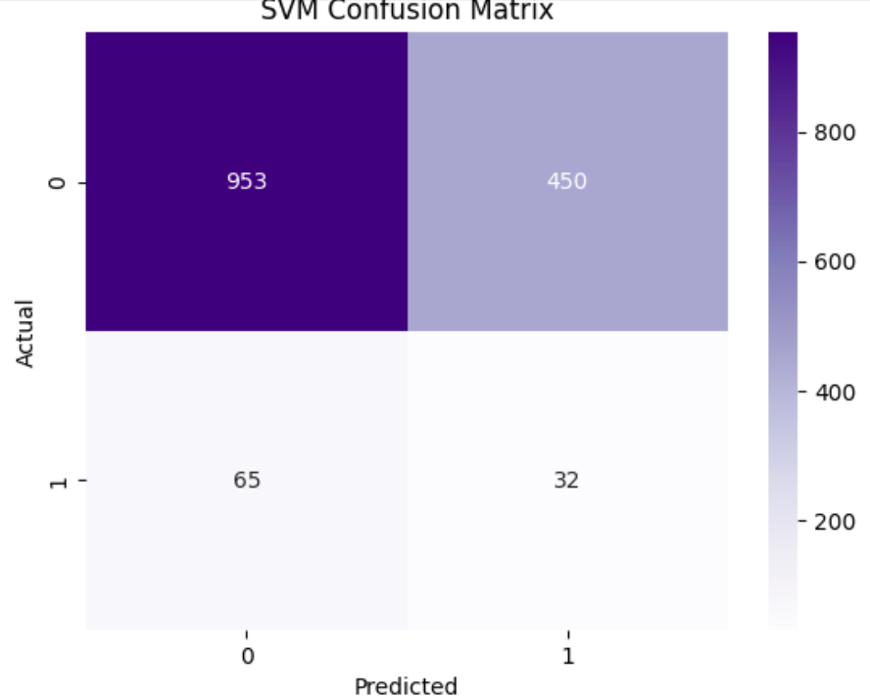
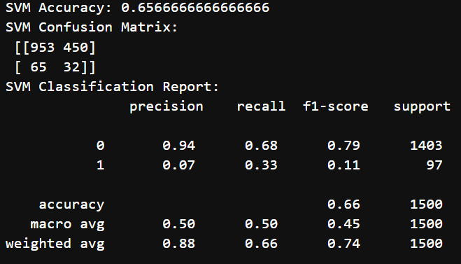
RESULT OBTAINED
Support Vector Machine

Slide 11
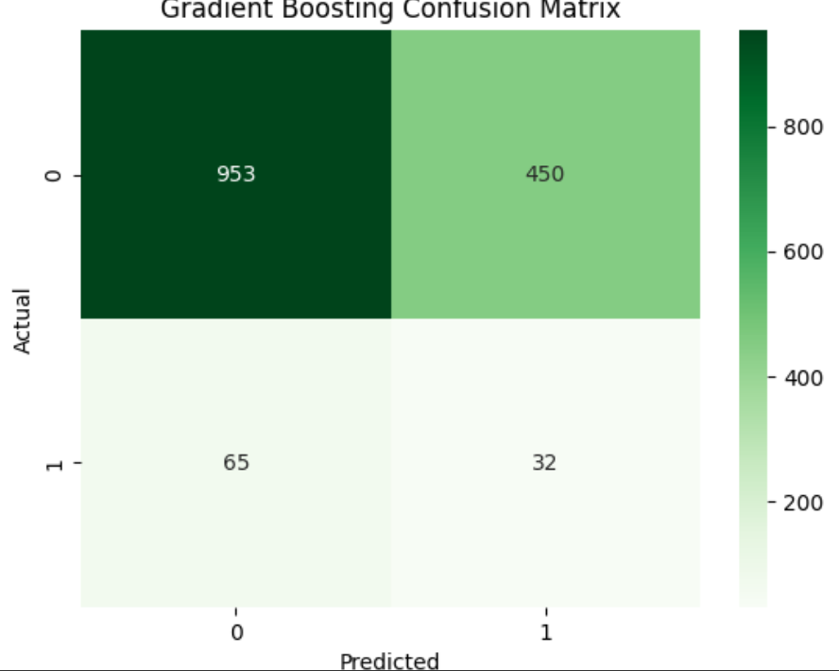
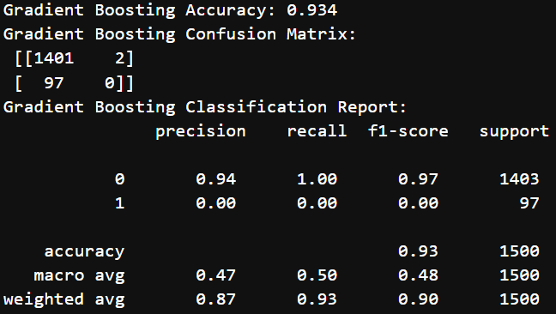
RESULT OBTAINED
Gradient Boosting

Slide 12
ACCURACY COMPARISON
MODEL | ACCURACY
Logistic Regression | 0.51
Random Forest | 0.93
K-Nearest Neighbors | 0.93
Support Vector Machine | 0.65
Gradient Boosting | 0.93

Slide 13
KEY INSIGHTS AND FINDINGS
Most fraudulent transactions are high-value or international transactions.
Certain devices and locations are more susceptible to fraud.
Users with many failed login attempts or unusual login activity are at higher risk.
Machine learning models like Random Forest ,KNN and GradientBoosting give better accuracy for detecting fraud.
Early detection can reduce financial losses and improve transaction security.

Slide 14
FUTURE IMPROVEMENTS
Use more real-time transaction data for better model accuracy.
Implement deep learning models to detect complex fraud patterns.
Add feature engineering like user behavior trends and transaction history.
Include real-time alerts for suspicious transactions.
Continuously update the model as new fraud patterns emerge.

Slide 15
CONCLUSION
Detecting fraud in digital payments is very important for safety.
Machine learning can help predict and stop fraud quickly.
Models like Random Forest ,KNN and GradientBoosting give good accuracy.
Cleaning and preparing data improves results.
Automated fraud detection saves money, time, and builds trust.

Slide 16
THANK YOU

